Slide 1

Intro to Software Engineering
LECTURE : SOFTWARE PROJECT MANAGEMENT

Slide 2
Software Project Management
Software & Project Management
Corporate America spends more than $275 billion each year on approximately 200,000 application software development projects
Most of these projects will fail for lack of skilled project management
Management problems were more frequently dominant cause than technical problems
Schedule overruns were more common (89%) than cost overruns (62%)
KPGM’s Survey in UK

Slide 3
Software Project Management (2)
Success Factors
User involvement – 20 points
Executive Support – 15 points
Clear Business Objectives – 15 points
Experienced Project Manager – 15 points
Small milestones – 10 points
Firm basic requirements – 5 points
Competent staff – 5 points
Proper planning – 5 points
Ownership – 5 points
Others – 5 points
Most of these points are of Management concern

Slide 4
Software Project Management (3)
Primary causes of software runaway
Project Objectives not fully specified
Bad planning and estimating
Technology new to the organization
Inadequate/No project management methodology
Insufficient senior staff on the team
Poor performance by Supplier of hardware/software

Slide 5
In a nutshell
“Organizations that attempt to put software engineering discipline in place before putting project management discipline in place are domed to fail”

Slide 6
Project
“A temporary endeavor undertaken to create a unique product, service or result”
A project is a temporary endeavor undertaken to create a unique product or service
Project Management Institute

Slide 7
Project Management
Project management is
The art of managing projects to a successful completion.
The Project Management Triple Constraint:
Scope
Quality
Cost
Time

Slide 8
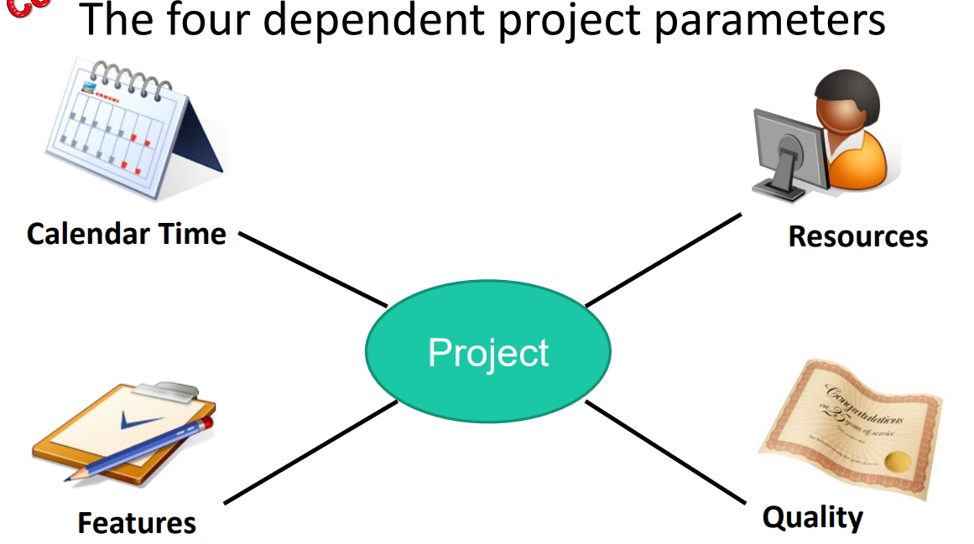

Slide 9
Terminology : Deliverable
Work product that is provided to the client
mock-up,
demonstration,
prototype,
report,
presentation,
Documentation
code
Release of a system or subsystem to customers or users.
Notes:
A schedule along with time estimates.
A prioritized list of features.
An example of the main page so we can review look and feel.
An archive of the old website
The final website

Slide 10
Terminology : Milestone
Completion of a specified set of activities (e.g., delivery of a deliverable, completion of a process step)
A milestone is a checkpoint in the project
A milestone has
A description of the point
A date
A person or persons who are responsible
A milestone may or may not have a deliverable associated with it.
A deliverable has
A description of a deliverable (scope)
A date (time)
A person or persons who are responsible (cost)

Slide 11
Terminology : Work Package
A work package is a large, logically distinct section of work:
– typically at least 12 months duration;
– may include multiple concurrent activities;
– independent of other activities
– but may depend on, or feed into other activities; – typically allocated to a single team.

Slide 12
Terminology : Work Product
A work product is a report, diagram, or collection of documents used by the business analyst during the requirements development process.
A work product may or may not become a deliverable.
It can be used to share information with stakeholders, elicit requirements, provide status
work product includes the beginning stages of a project, proposals, agendas, reports, analysis and information on the project. A deliverable, on the other hand, is the end result of the project.

Slide 13
Terminology : Task
A task is typically a much smaller piece of work:
– A part of a workpackage.
– typically 3–6 person months effort;
– may be dependent on other concurrent activities;
– typically allocated to a single person.

Slide 14
Terminology : Activity
– Must have a clear start and a clear stop
– Must have a duration that can be forecasted
– May require the completion of other activities before it begins
– Should have some deliverables for ease of monitoring

Slide 15
Terminology
Event
The end of a group of activities, e.g., agreement by all parties on the budget and plan
Dependency
An activity that cannot begin until some event is reached
Resource
Staff, time, equipment, or other limited resources required by an activity.

Slide 16
Standard Approach to Project Management
The scope of the project is defined early in the process.
The development is divided into tasks and milestones.
Estimates are made of the time and resources needed for each task.
The estimates are combined to create a schedule and a plan.
Progress is continually reviewed against the plan, perhaps weekly.
The plan is modified by changes to scope, time, resources, etc.
Typically the plan is managed by a separate project management team, not by the software developers.

Slide 17
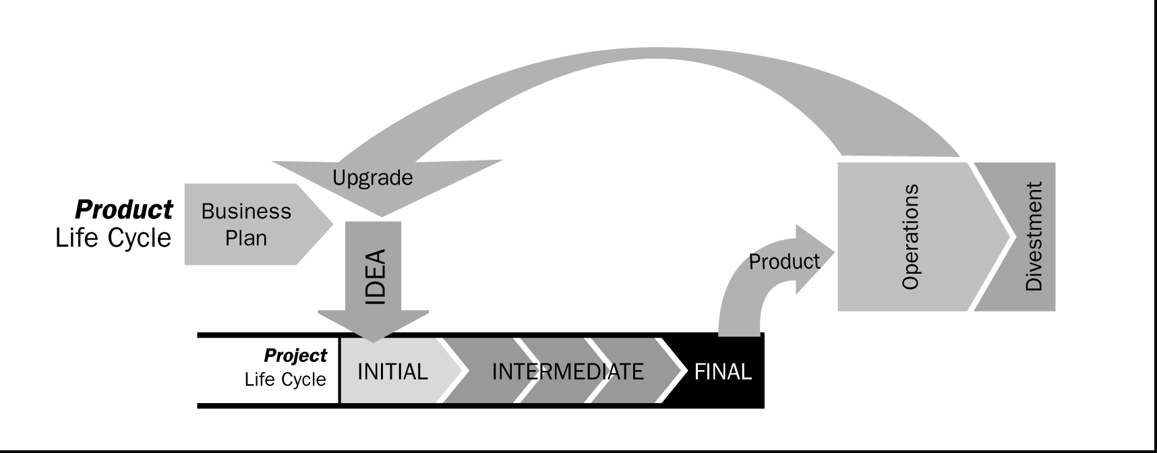
Product and the Project Life Cycles
Notes:
Projects are finite; they have a defined start and end date and are essentially one and done.
A product focused model, on the other hand, is tied to the natural product lifecycle—you are never done until the product reaches its end of life. Resources are also flexible to meet the demands of the product lifecycle and your backlog of items has a much smaller time horizon. The product-oriented approach makes it much easier to manage the ongoing health and maintenance of the product.
A big project, however, can last years. Alternatively, a typical product backlog in a product model, usually has a horizon of no more than a few months.
PMBOK 2004: Add more
Divestment>> remove, take off, remove
In some application areas, such as new product development or software development, organizations consider the
project life cycle as part of the product life cycle.

Slide 18
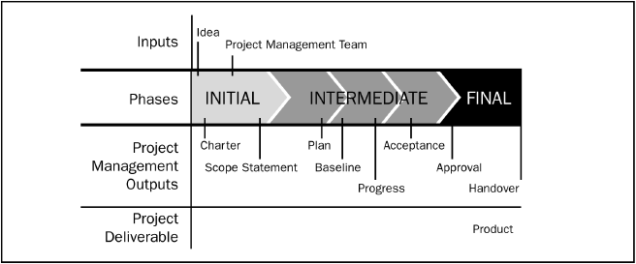
Phases in a Project Life Cycle

Slide 19
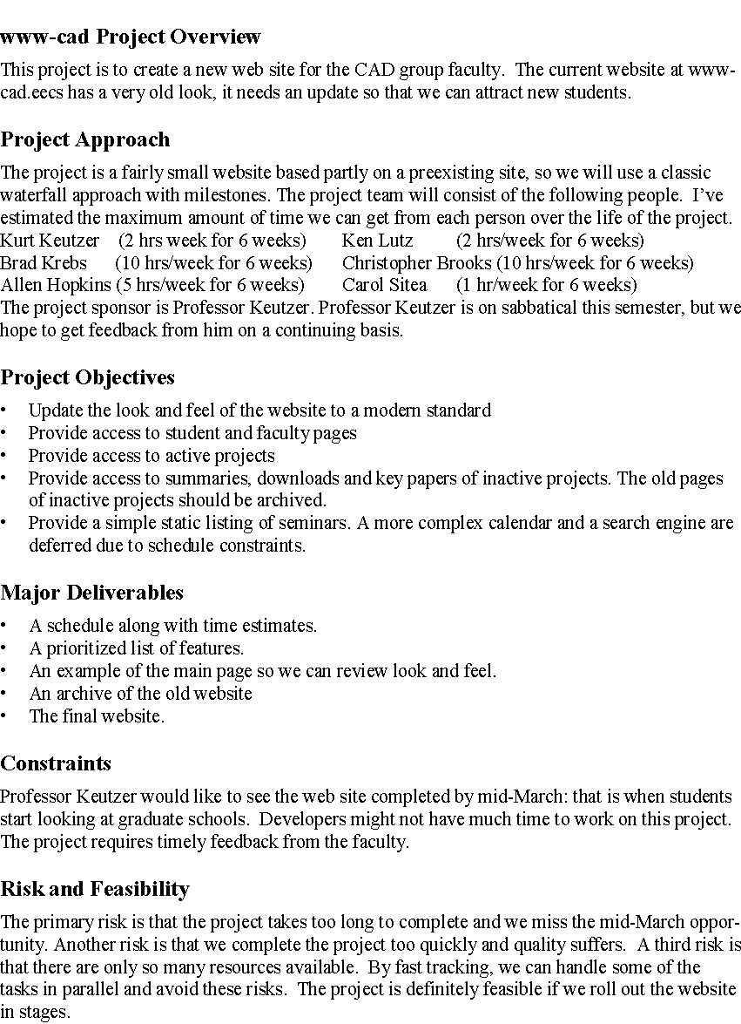
Project Charter Example: Web Site
One page!

Slide 20
Project Management Life Cycle
Processes/Activities of the 5 phases (Process Groups 2004) are as:
1. Scope the Project
State the Problem/ Opportunity
Establish the project goal
Define project Objectives
Identify the success criteria
List assumptions, risks, obstacles
2. Develop detail Plan
Identify project activities
Estimate activity duration
Determine resource requirements
Construct / analyze project network
Prepare project proposal
3. Launch the Plan
Recruit and organize project team
Establish team operating rules
Level resources
Schedule work packages
Document work packages
4. Monitor/ Control Progress
Establish progress reporting system
Install change control tools/process
Define problem-escalation process
Monitor project progress vs plan
Revise Plan
5. Close Out
Obtain client acceptance
Install project deliverables
Complete project documentation
Complete post-implementation audit
Issue final project report
Notes:
Commonalities between phases for Product and Project (system) development with project phases 1 00,101

Slide 21
Knowledge Areas for Project Management
Project Integration Management
Project Scope management
Project Time Management
Project Cost Management
Project Quality Management
Project Human Resource Management
Project Communications Management
Project Risk Management
Project Procurement Management
[PMBOK PMI]
Notes:
+PMI-8
The knowledge areas are the core technical subject matter, which are necessary for effective project management.

Slide 22
1. Project Planning

Slide 23
Project Planning Tools
Critical Path Method, Gantt charts, Activity bar charts
• Build a work-plan from activity data.
• Display work-plan in graphical or tabular form.
Project planning software (e.g., Microsoft Project)
• Maintain a database of activities and related data
• Calculate and display schedules
• Manage progress reports

Slide 24
1. Software Project Planning
The purpose of the Project Plan is to
define and establish the management strategy for achieving the goals of the project.
The project development plan is used to:
Guide project execution.
Document project planning assumptions.
Document project planning decisions regarding alternatives chosen.
Facilitate communication among stakeholders.
Define key management reviews (as to content, extent, and timing).
Provide a baseline for progress measurement and project control.
Notes:
Extent >> amount

Slide 25
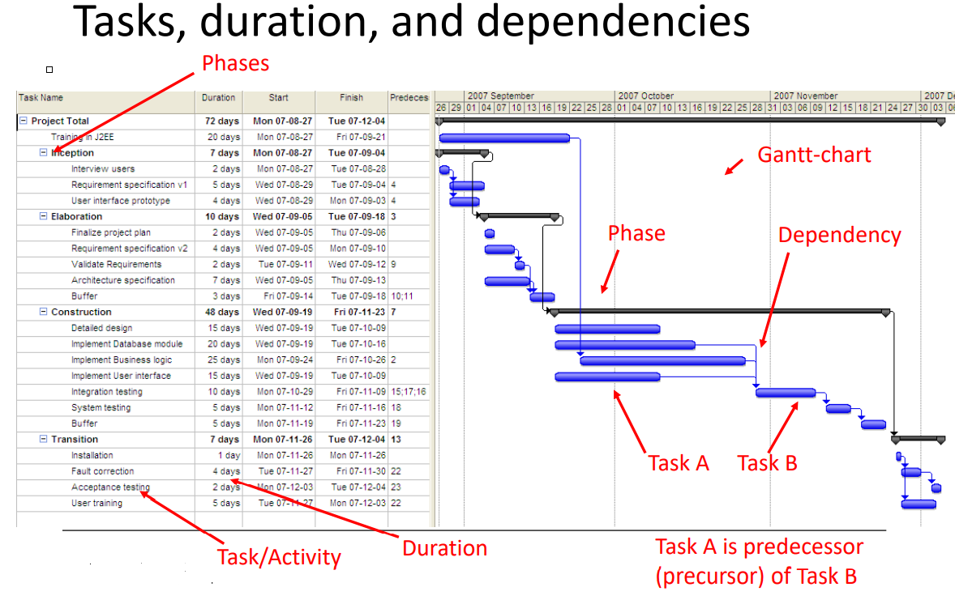

Slide 26
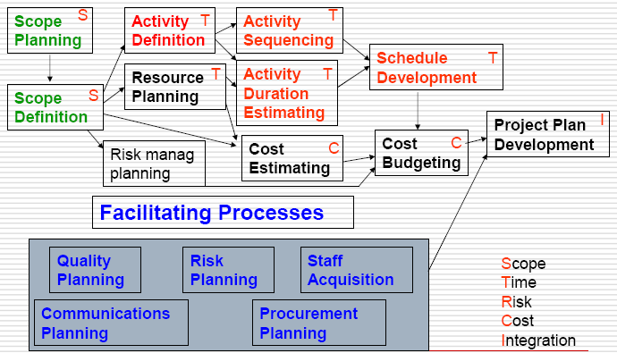
Planning Process Flow

Slide 27
Types of Plans
Software development plan :The central plan, which describes how the system will be developed.
Quality assurance plan : Specifies the quality procedures & standards to be used.
Validation plan. Defines how a client will validate the system that has been developed.

Slide 28
Types of Plans
Configuration management plan : Defines how the system will be configured and installed.
Maintenance plan : Defines how the system will be maintained.
Staff development plan: Describes how the skills of the participants will be developed.

Slide 29
The Project Plan- Format
Contents
Many format; common sections are: (kathy -62)
Introduction or Overview
Project Name, Description and Need it addresses, Sponsor's name, Name of PM, Deliverables (Brief), Reference Material, List of definitions.
Project Organization
Org. chart, Responsibilities, Other Org. or process related info.
Management and Technical Approach
Manage Objectives, project control, Risk Manage, Staffing, Technical Processes.
Project Scope
Major Work Packages/WBS, Key Deliverables, Other Work related Info.,
Project Schedule
Summary/Detail Schedules
Budget
Summary/Detail budget,

Slide 30
2. Scope Definition

Slide 31
The first step - define the Scope
“Scope” The term may refer to:
Product scope - the features and functions that are to be included in a product or service.
Project scope - the work that must be done in order to deliver a product (with the specified features and functions).
Product Scope is defined in the product requirements and is the subject of the product life cycle
Project Scope is defined in the project charter and is the subject of the project plan (Kathy-ch4)
Scope
& Quality
Time
Cost
Resource Availability

Slide 32
Decomposition
Subdividing the major project deliverables into smaller, more manageable
Components (products) in sufficient detail
to support future project activities (planning, executing, controlling, and closing)
Requires Steps:
Identify the major elements (deliverable) of the project.
Identify constituent elements (Work Products) of the deliverable.
Decide if adequate cost and duration estimates can be developed at this level of detail for each element.

Slide 33
WBS-Work Breakdown Structure
Overall work has to be decomposed into manageable units
Complex tasks are broken down into subtasks and further refined called Work Breakdown Structures (WBS)
Notes:
Improve accuracy of cost, time, and resource estimates.
Define a baseline for performance measurement and control.
Facilitate clear responsibility assignments.

Slide 34
WBS-Work Breakdown Structure
There are many ways of breaking down the activities in a project, but the most usual is into:
– work packages;
– tasks/Activities
– deliverables/Work Products
– milestones

Slide 35
WBS Framework
A framework dictating the number of levels and the nature of each level may be imposed on a WBS (e.g. IBM recommended five levels):
Level 1: Project.
Level 2: Deliverables (such as software, manuals and training courses)
Level 3: Components; Which are the key work items needed to produce deliverables (e.g. modules and tests required to produce the system software)
Level 4: Activities (Work-packages which are major work items, or collections of related tasks, required to produce a component)
Level 5: Tasks (tasks that will normally be the responsibility of a single person).

Slide 36
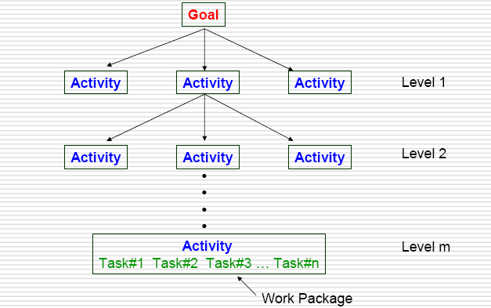
Hierarchy of WBS

Slide 37
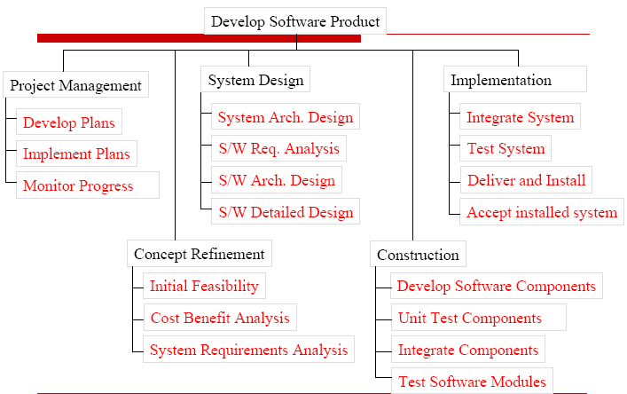
WBS Template for Software Development Project

Slide 38
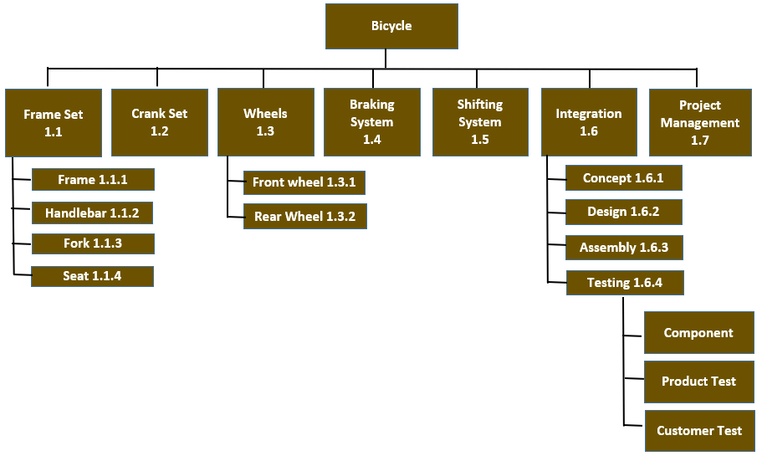
Example

Slide 39
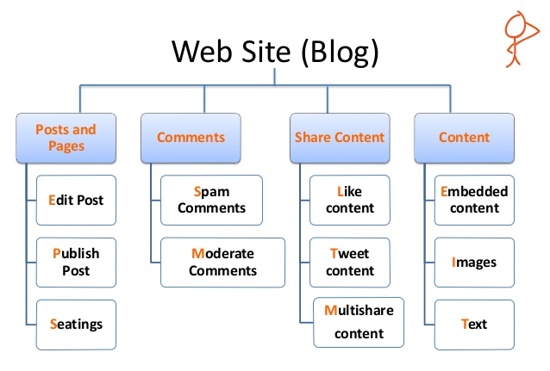
Examples

Slide 40
3. Activity Planning

Slide 41
Planning And Scheduling
Need to develop a schedule in which planned start and end dates are assigned to all activities
Activity precedence & Dependencies
Activity duration
Available resources
Steps
Define activities (Gantt chart )
Sequence activities (CPM )
Estimate time (PERT)

Slide 42
Task Dependencies
Task Dependencies (relationships)
A
B
Finish-to-start (FS): Task (B) cannot start until task (A) finishes
A
Start-to-start (SS): Task (B) cannot start until task (A) starts
B
Finish-to-Finish (FF): Task (B) cannot finish until task (A) finishes
A
Start-to-finish (SF): Task (B) cannot finish until task (A) starts
A
B
B
Notes:
Kathy

Slide 43
Scheduling as precedence
F
S
A: Designing
A: Testing
B: Coding
B: Debugging
S
S
F
S
A: Coding
A: Release
B: Unit Testing
B: Bug Fixing
F
F

Slide 44
Gantt chart - Define activities
Developed in 1918 by H.L. Gantt
■ Graph or bar chart with a bar for each project activity that shows passage of time ■ Provides visual display of project schedule

Slide 45
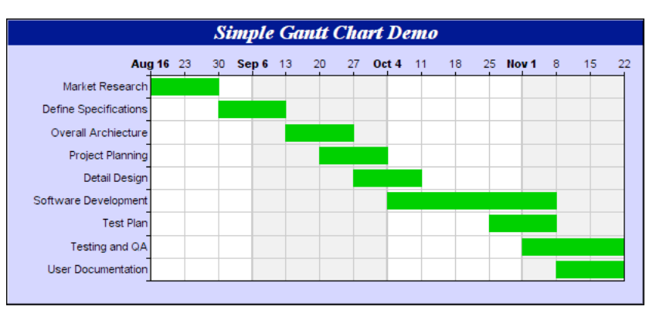
Gantt Chart

Slide 46
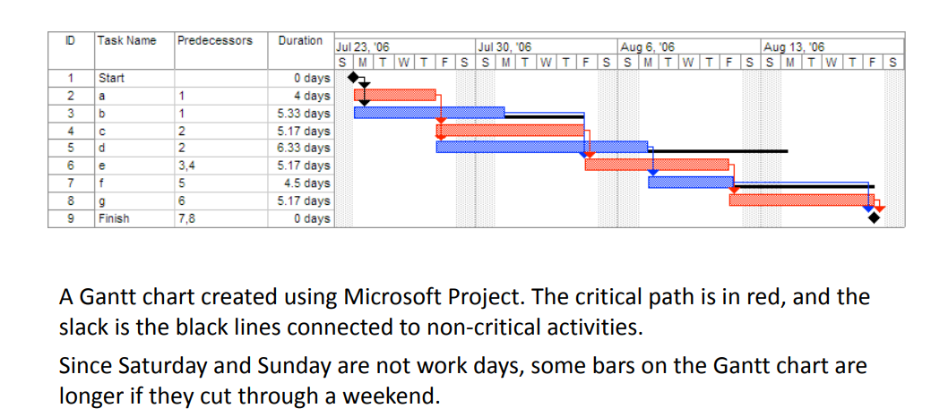
Gantt Chart

Slide 47
Project Network Diagrams
Project network diagrams (PND) are the preferred technique for showing activity sequencing
A project network diagram is a schematic display of the logical relationships among, or sequencing of, project activities
Arrow Diagramming Method (ADM)
Also called activity-on-arrow (AOA) project network diagrams
Activities are represented by arrows
Nodes or circles are the starting and ending points of activities
Can only show finish-to-start dependencies
Precedence Diagramming Method (PDM)
Activities are represented by boxes
Arrows show relationships between activities
More popular than ADM method and used by project management software
Better at showing different types of dependencies
Notes:
Network (precedence) diagram – diagram of project activities that shows sequential relationships by the use of arrows and nodes.
Activity-on-arrow (AOA) – a network diagram convention in which arrows designate activities.
Activity-on-node (AON) – a network diagram convention in which nodes designate activities.

Slide 48
Basic Project Network Diagrams (PND)…..
2
D
5
H
A=?
E
1
B=?
3
6
J
AOA (ADM);
CPM adds more inf at nodes
8
F
C=?
I
4
7
G
A
Start: ID:
Finish: Dur:
Res:
D
Start: ID:
Finish: Dur:
Res:
PDM
H
Start: ID:
Finish: Dur:
Res:
B
Start: ID:
Finish: Dur:
Res:
E
Start: ID:
Finish: Dur:
Res:
J
Start: ID:
Finish: Dur:
Res:
F
Start: ID:
Finish: Dur:
Res:
C
Start: ID:
Finish: Dur:
Res:
G
Start: ID:
Finish: Dur:
Res:
I
Start: ID:
Finish: Dur:
Res:
Task Box of MS Project 2000: Activity Name Start: ID: Finish: Dur: Resource:

Slide 49
Terminology: Network Diagram
Path
Sequence of activities that leads from the starting node to the finishing node
Critical path
The longest path; determines expected project duration
Critical activities
Activities on the critical path
Slack
Allowable slippage for path; the difference the length of path and the length of critical path

Slide 50
Terminology: Network Diagram
Slack time (also known as float)
is the amount of delay expressed in units of time that could be tolerated in the starting time or completion time of an activity without causing a delay in the completion of the project.
Slack time is the difference between the late finish and the early finish (LF-EF).
If the result is greater than zero, then the activity has a range of time in which it can start and finish without delaying the project completion date
Notes:
If an activity has zero slack, it determines the project completion date. In other words, all the activities on the critical path must be done on their earliest schedule or the project completion date will suffer.
If an activity with total slack greater than zero were to be delayed beyond its late finish date, it would become a critical path activity and cause the completion date to be delayed.
The sequence of activities that has zero slack is defined as the critical path
In general, the critical path is the path that has minimum slack.

Slide 51
Sequence activities (Critical Path Method CPM )
project network analysis technique used to predict total project Duration
primary objectives:
Planning the project to complete it as quickly as possible
Identifying those activities where a delay in their execution
affect the overall end date of the project or ‘later activities’ start dates.
represents activities as links (arrowed lines) in the graph
nodes (circles) represent the events of activities start and finish.
A link represents an activity (and has duration)
A slack period is one in which there is not much work or activity.
Slack time = Latest start time - Earliest start time.

Slide 52
Critical path method
A forward pass analysis performs schedule calculations that identify the early start and ﬁnish dates of activities and the project
A backward pass analysis performs schedule calculations that identify the late start and ﬁnish dates of activities and the project, as well as total and free ﬂoat
Total ﬂoat (TF) is the amount of time an activity can be delayed without delaying the project as a whole
Free ﬂoat (FF) is the amount of time an activity can be delayed without delaying its successor (dependent) activities
Note that total ﬂoat is global to the project, while free ﬂoat is local to the neighborhood of the activity

Slide 53
Terminology: CPM
Network activities
ES: early start
EF: early finish
LS: late start
LF: late finish
Used to determine
Expected project duration
Slack time
Critical path

Slide 54
CPM –Forward Pass
ES : 1
EF : ES +Duration - 1
ES of Next Activity : EF of previous activity +1
EF of next Activity : ES+Duration-1

Slide 55
CPM – Backsword Pass
LF = EF of last activity
LS = LF-Duration+1
LF of prev Activity = LS -1 of Prev Activity
https://www.pmexamsmartnotes.com/how-to-calculate-critical-path-float-and-early-and-late-starts-and-finishes/3/
Notes:
https://www.pmexamsmartnotes.com/how-to-calculate-critical-path-float-and-early-and-late-starts-and-finishes/3/

Slide 56
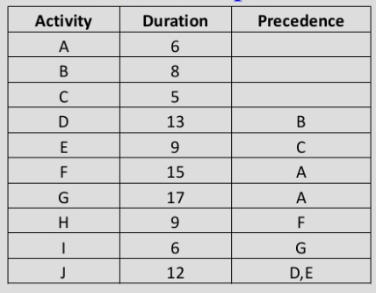
Example

Slide 57
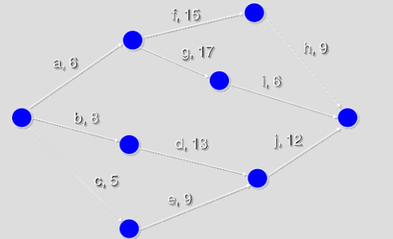

Slide 58
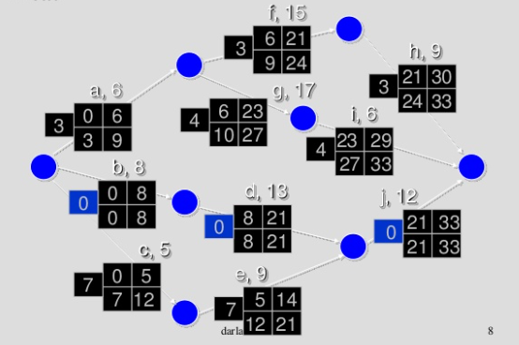

Slide 59
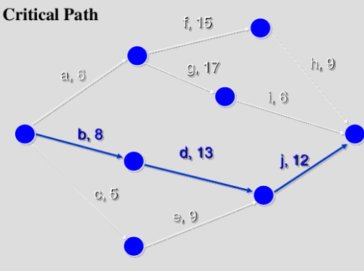

Slide 60


Slide 61
Activity |  | Duration (weeks) | Precedents
A | Hardware selection | 6
B | Software design | 4
C | Install hardware | 3 | A
D | Code & test software | 4 | B
E | File take-on | 3 | B
F | Write user manuals | 10
G | User training | 3 | E
H | Install & test system | 2 | C

